Slide 1


Prototype Submission Phase

Slide 2

TEAM NAME – Aerovators
Team Members
Mrudula More - Real time navigation Screen, alternate route
Chinmay Deotale - Socket, ML Model
Aditi Sahu - Backend, Flask Server
Rahul Kumar - Sensor and Reports Screen, ML Model
THEME 1: Enhancing Flight Navigation Mechanism for Optimal Route Planning and Risk Mitigation

Slide 3
PROBLEM STATEMENT
To develop a solution that optimizes flight navigation by integrating real-time data to identify safe routes and provide real-time risk assessments.

Slide 4
PROPOSED SOLUTION
Platform for Pilots and Airline Operators
A web application optimizing flight navigation by integrating real-time data for safe route identification and risk assessments.
Real-Time Tracking: Pilots can track optimal paths, view current weather conditions, and monitor flight health reports from sensors.
Comprehensive Access: Airlines have complete access to viewing flight data and navigation updates.
Authentication features
Interactive Dashboard: Features an interactive and responsive dashboard for meaningful insights and decision-making.

Slide 5
METHODOLOGY – Tech Stack
-Frontend:
Framework - React
Design- Tailwind
State Management - redux
connection - Axios
-Backend:
Framework- Node, Express
Authentication - JWT
Database: MongoDB
Machine Learning Model Server: Python Flask

Slide 6
High Level Design
Flask Server
Request Model to predict
ML Models
Datasets
Training (ML Algorithm)
Prediction
API endpoints
Server (NodeJS)
Database
(MongoDB)
Send/Retrieve Data
Authentication via JWT
HTTP/Socket.io Request/ Response
Connect/ Connection Event
Client 1
Client 2

Slide 7
METHODOLOGY – Activity Diagram
Login
Pilot
Airline
Navigation
Active Flights
Sensor
Reports
Reports
Logout

Slide 8
MongoDB Schema Design
flightHistory
User
Flight History
Sensor
id
cycle
setting1
setting2
setting3
s1
s2
s3
.
.
.
s20
s21
seq
flightId
User
Coordinate
source
destination
currentLocation
longitude
latitude
planePaused
status
weatherError
sensorErrorCount
_id
username
password
userType

Slide 9
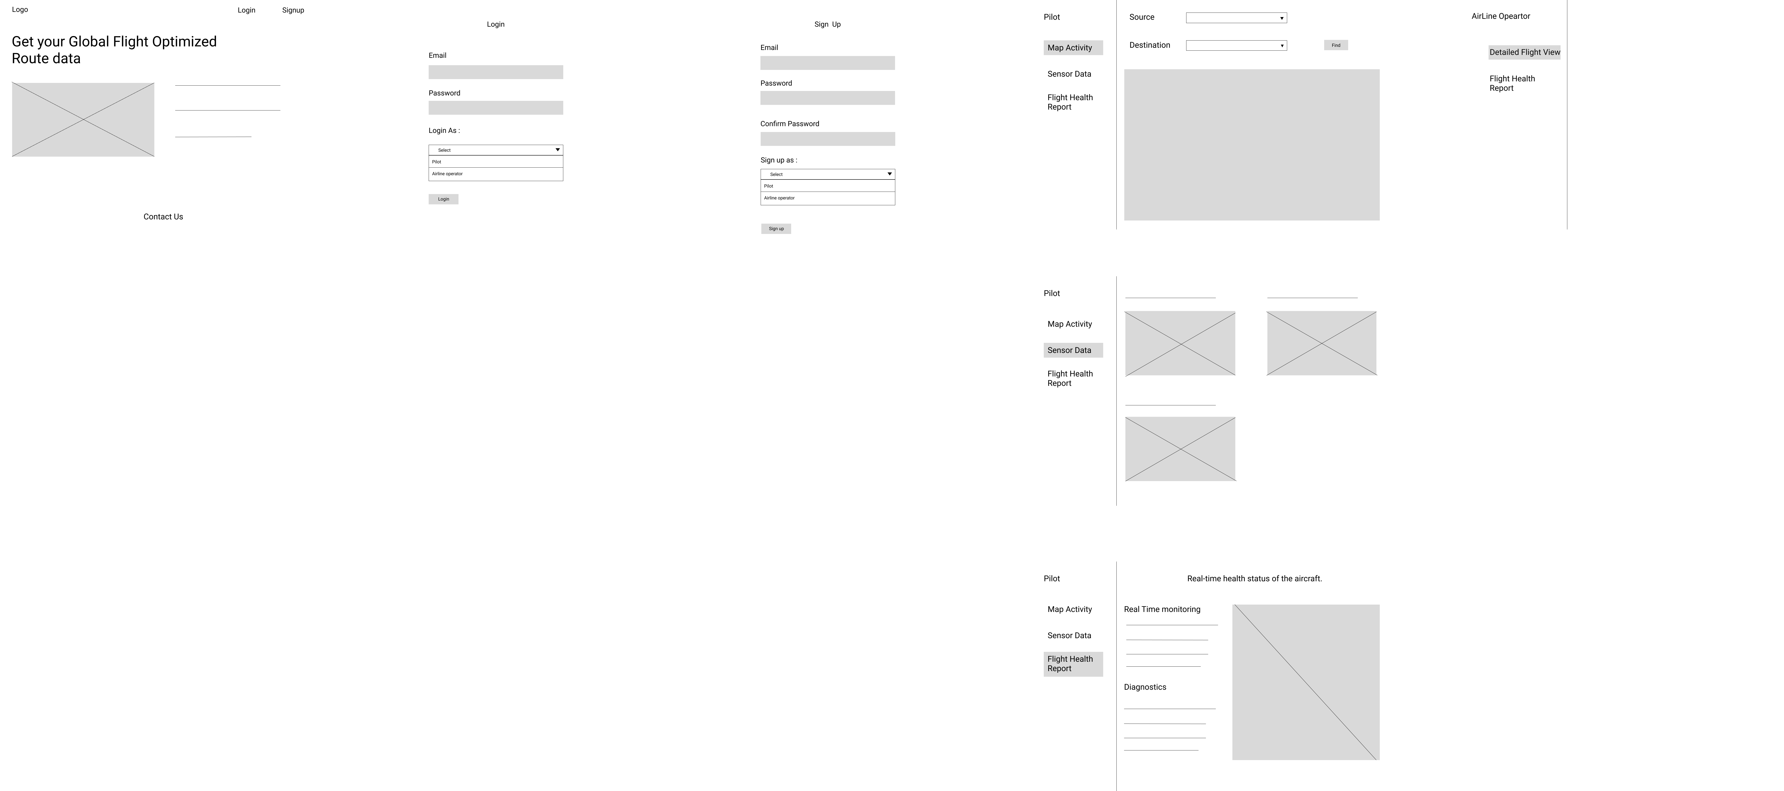
WireFrame

Slide 10
DataSet Sources
engine data - https://www.kaggle.com/datasets/aadharshviswanath/aircraft-sensor-and-engine-performance/data
visibility weather data - https://www.kaggle.com/datasets/aadharshviswanath/flight-data/data
Classification ML Report
Weather Model
RandomForestClassifier
Accuracy: 0.886
Sensor Model
RNN algorithm
Accuracy: 92.58

Slide 11
WORKING PROTOTYPE
Demo Link: https://drive.google.com/drive/folders/1sSdKCa_Mn77VuzN0bx5TowxmpUgk1O96?usp=sharing

Slide 12
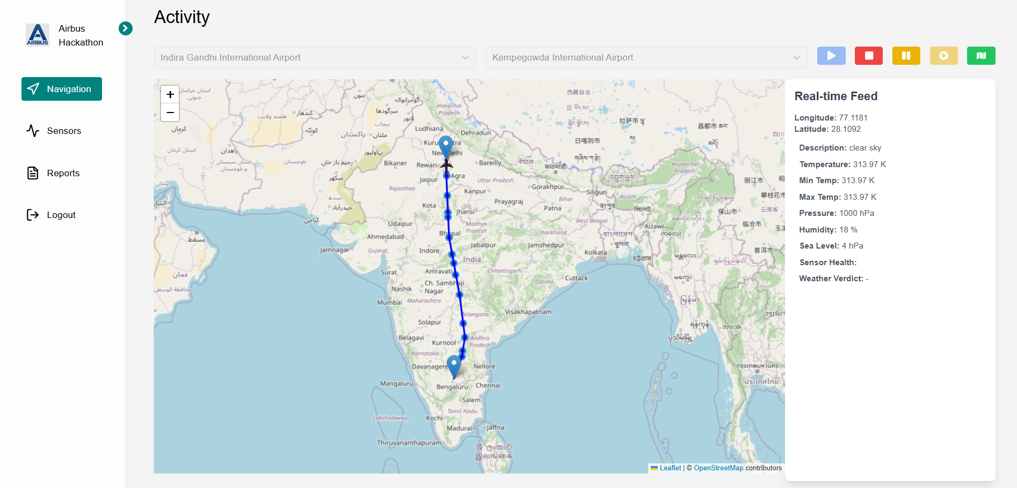
Project UI

Slide 13
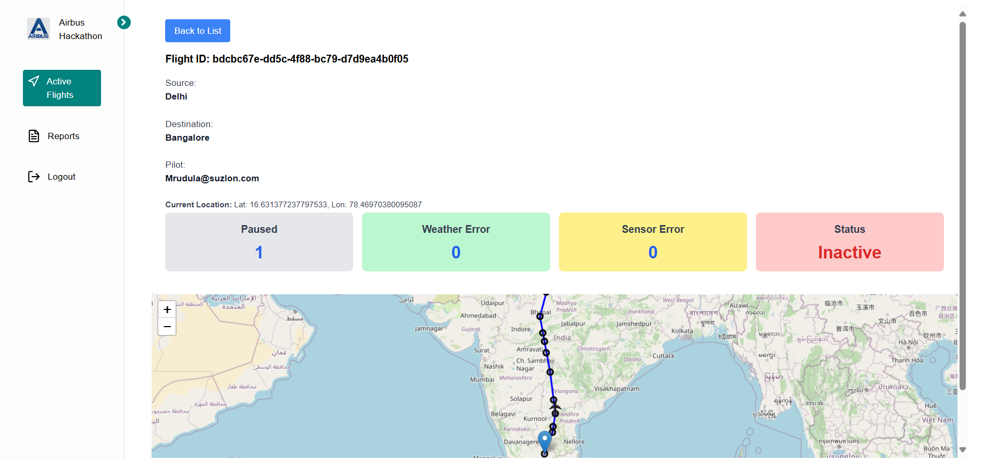
Project UI

Slide 14
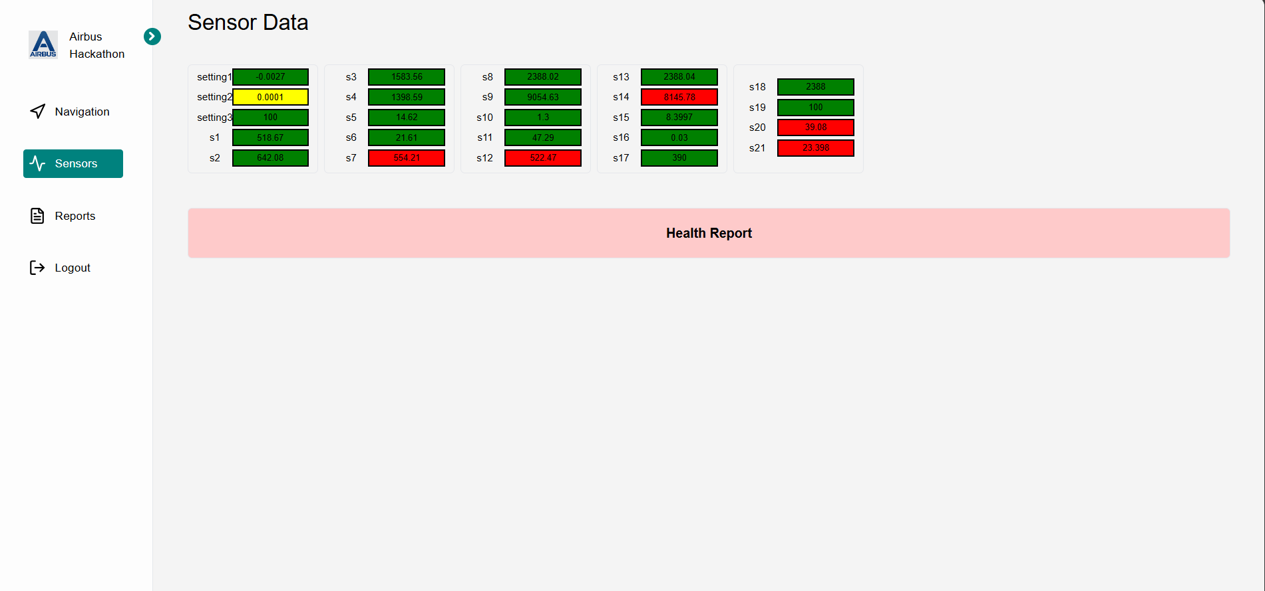
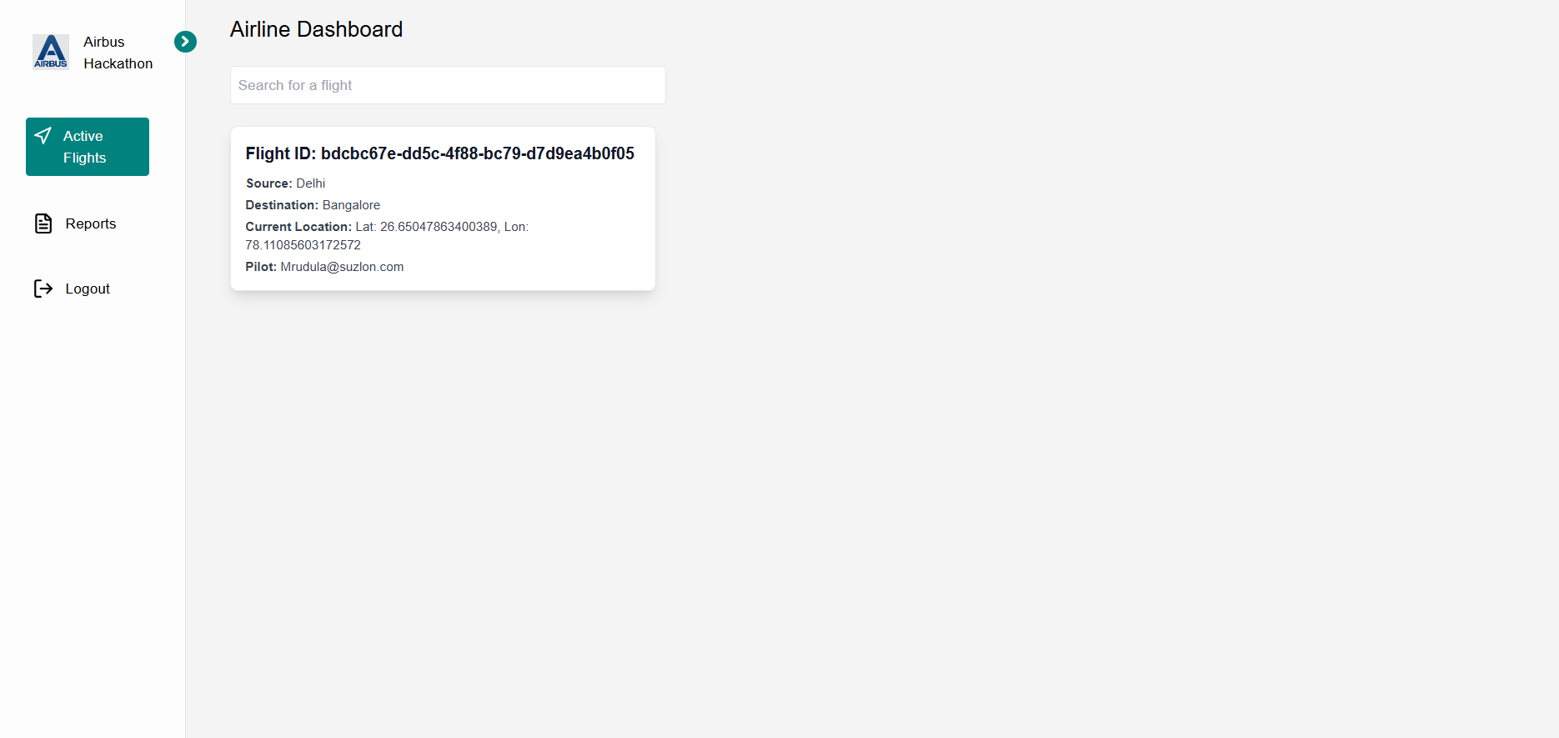
Project UI

Slide 15
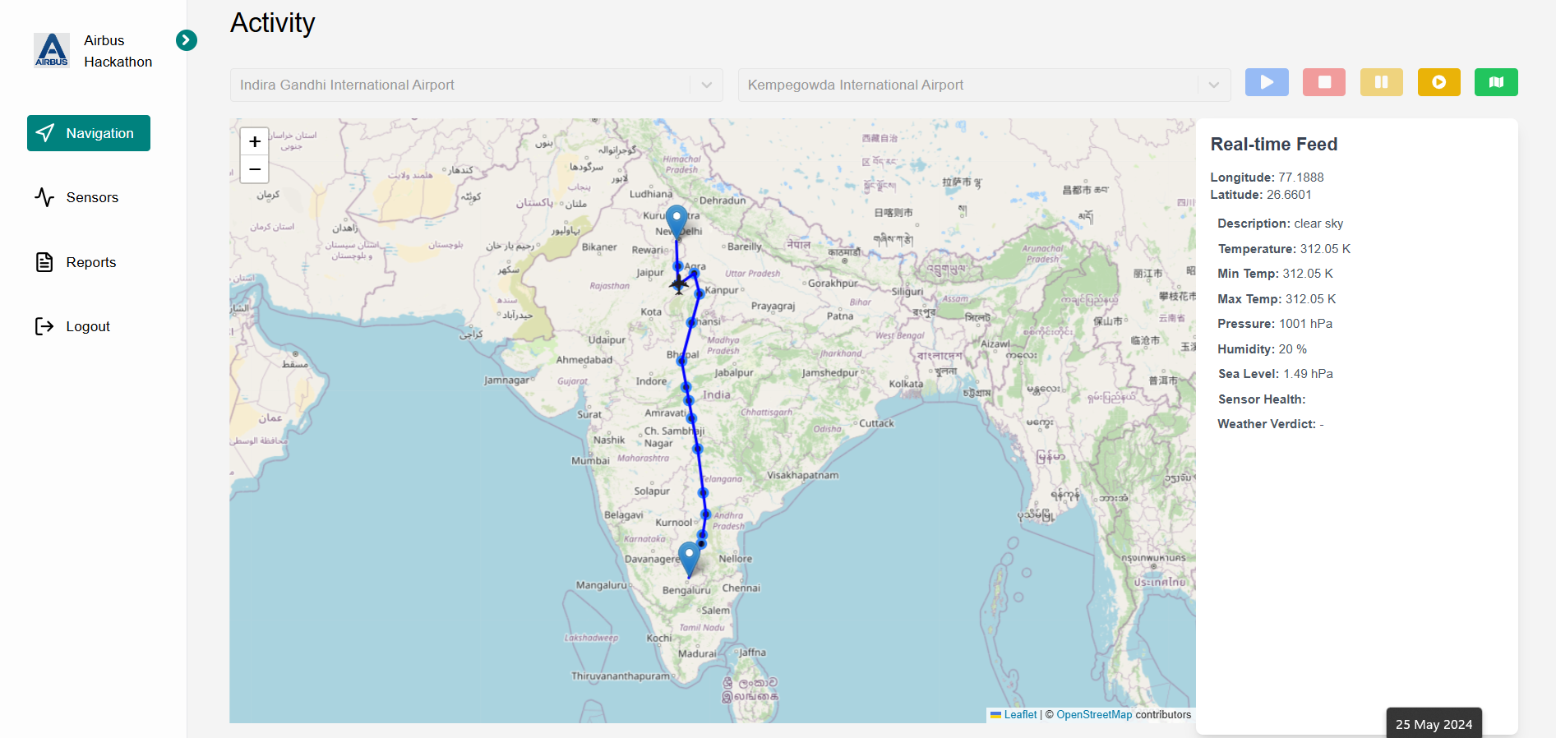
Project UI

Slide 16
Project Repository and Instructions to run
Repository Link: https://github.com/DeotaleChinmay2001/Aerothon6.0
Backend (Nodejs Server)
npm init –y
npm install
nodemon server.js
Client
npm init –y
npm install
npm run dev
Flask Server
python app.py

Slide 17


